Slide 1
Lecture 5 Introduction to Classes and Objects
CS331 Introduction to C++ and Object Oriented Programming

Slide 2
What is a Class?
A class is a C++ mechanism for implementing objects (creating new data types)
A class defines
data members to implement attributes
methods to implement behaviors
Classes support encapsulation, the separation of an object’s interface from its implementation
Object: An instance of a class

Slide 3
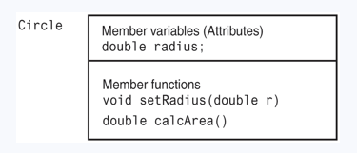
What is a class?
This figure shows a representation of what a Circle class might look like. It has just one member variable to hold data and two member functions. The Circle class’s member variable is radius. Its setRadius member function sets the radius, and its calcArea member function calculates and returns the area.

Slide 4
Class Definition
class class-name {
public:
public members
private:
private members
}; <== Note

Slide 5
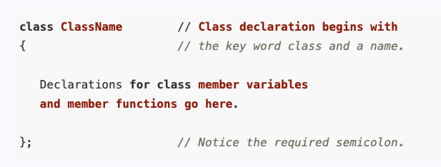
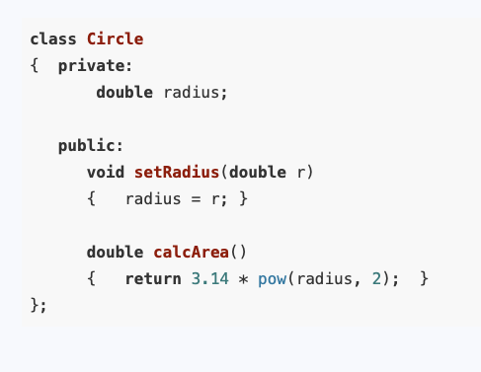
Creating your own class
Example:

Slide 6
Member access specifiers
public: Be accessed by any function in the program
private: Be accessed by member functions of the class or friends
Default access mode: private
Access specifier applies until the next access specifier

Slide 7
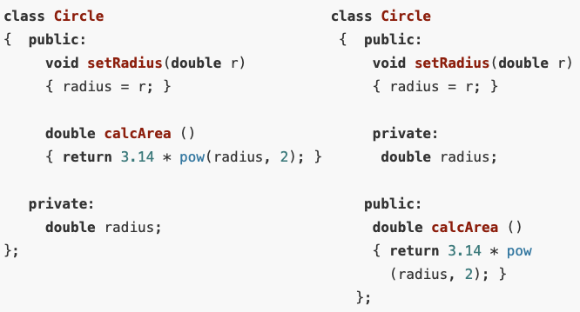
Placement of private and public Members
Both are legal

Slide 8
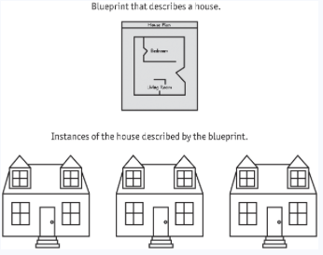
Creating and Using Objects
Objects are instances of a class. They are created with a definition statement after the class has been declared.

Slide 9
Creating and Using Objects
Objects are instances of a class. They are created with a definition statement after the class has been declared.
Circle circle1, circle2;
They are two distinct instances of the Circle class, with different memory assigned to hold the values stored in their member variables.

Slide 10

Creating and Using Objects

Slide 11
Accessors and Mutators
A function that uses the value of a class variable but does not change it, is known as an accessor.
The class member function calcArea only uses, but does not modify, the member variable radius
A member function which stores a value in a member variable or changes its value, is known as a mutator.
The function setRadius modifies the contents of radius

Slide 12
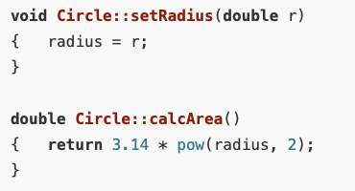

Defining Member Functions
Class member functions can be defined either inside or outside the class declaration.
When a function body is longer, we place a prototype for the function in the class declaration, instead of the function definition itself. We then put the function definition outside the class declaration, either following it or in a separate file.
Definitions: Outside class
Prototype: Inside Class

Slide 13
Naming Conventions for Class Member Functions
It is common to name a mutator with the word set followed by the name of the member variable whose value it is setting.
e.g. setLength,setWidth
It is common to name an accessor with the word get followed by the name of the member variable whose value it is getting if all it does is return the value stored in the variable.
e.g. getLength, getWidth

Slide 14
Constructors
A constructor is a member function that is automatically called when a class object is created.
Most often programmers use a constructor to initialize an object’s member variables. However, it can do anything a normal function can do.

Slide 15
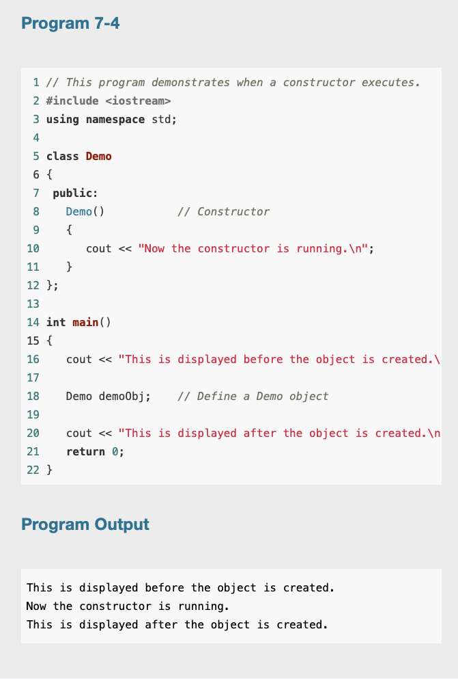
Constructors

Slide 16
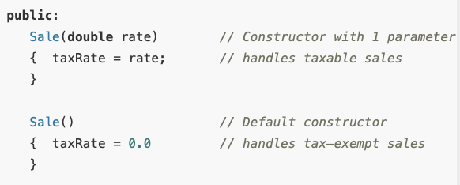
Overloading Constructors
Class member functions may be overloaded, including the constructor. One constructor might take an int argument, for example, while another constructor takes a double. There could even be a third constructor taking two integers. As long as each constructor has a different list of parameters, creating a unique signature, the compiler can tell them apart.

